Slide 1
Workplace Literacy and Essential Skills
Learning for Success Project

Slide 2
Project Overview
One-year, condensed project
Project partners:
Literacy Link South Central
Goodwill Ontario Great Lakes retail stores across Southwestern Ontario
Employment Ontario

Slide 3
Project Deliverables
Performing initial round of Learning for Success explorations (one-on-one interviews) with all retail store staff
Analyzing results of explorations to determine gaps in knowledge and skills
Administering PDQ pre-assessments for all staff willing to participate to determine current skill levels
Delivering training in 12 subject areas, determined by needs of staff
Administering PDQ post-assessments for all staff who had pre-assessments and training to determine increase in skills

Slide 4
Initial LFS Explorations
Explorations and training were performed at 10 retail locations:
Adelaide Street bookstore
Horton Street
Oxford Street East
Pond Mills outlet store & transportation
Sherwood Forest Mall
Kitchener/Cambridge
Guelph
Stratford
St. Thomas
Woodstock
187 staff participated

Slide 5
Pre-Assessments
PDQ assessments were administered on 74 staff
Measures Essential Skills:
Reading Text
Document Use
Numeracy
CAMERA assessments were administered on 9 staff
Measures Essential Skills:
Reading Text
Document Use
Writing
Numeracy
We found huge differences in skill levels across the province

Slide 6
Training Modules
Staff made suggestions about training they would like to see brought on-site
LFS project staff recognized some learning needs
12 training modules were created using Moodle
Introduction to Computer Basics
Introduction to Online Learning
Accessible Customer Service
Understanding Quality Goods
Respectful Workplaces
Internal Policy Refresher
Health and Safety
WHMIS
Business Metrics
How to Read Your Pay Stub
Loss Prevention
Family Literacy

Slide 7
Introduction to Computer Basics
Designed for employees who have never used a computer before
Topics covered:
Navigating Windows
Accessing Windows help and support
Using a mouse
Using a keyboard
Accessing the internet and performing a Google search
Setting up email and Moodle account

Slide 8
Introduction to Computer Basics
Book resources
Interactive activities

Slide 9
Introduction to Online Learning
Designed to get employees comfortable in an online learning environment
Teaches:
History of Moodle
Navigation of Moodle
Types of activities in Moodle
Individual Moodle profile
Updating information
Course history
Sending messages through Moodle

Slide 10
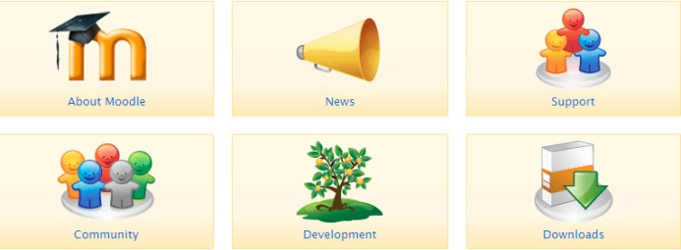
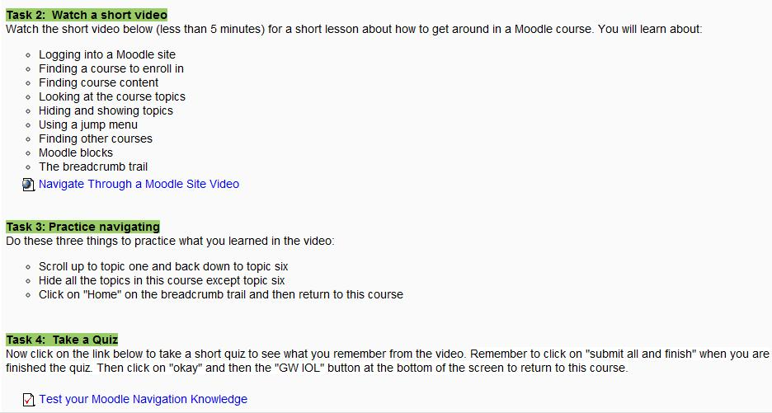
Introduction to Online Learning
Embedded videos
Quizzes

Slide 11
Introduction to Online Learning
Types of activities in Moodle:
Choice activities
Quizzes
Written assignments
Journal entries
Wiki entries
Questionnaires

Slide 12
Accessible Customer Service
Designed to familiarize employees with Accessibility for Ontarians with Disabilities Act (AODA)
Teaches:
Recognizing that some customers face challenges
Visible disabilities
Non-visible disabilities
Making services accessible for all
Dealing with customers in a way that promotes equal treatment and quality service
Goodwill’s Accessible Service policy

Slide 13
Accessible Customer Service
Web links

Slide 14
Understanding Quality Goods
Designed for employees who work in sorting and hanging
Teaches:
Recognizing the differences between brand quality
How to price items that are higher quality
Analyzing fabric quality, designer/label, washing instructions, etc. to determine item price

Slide 15
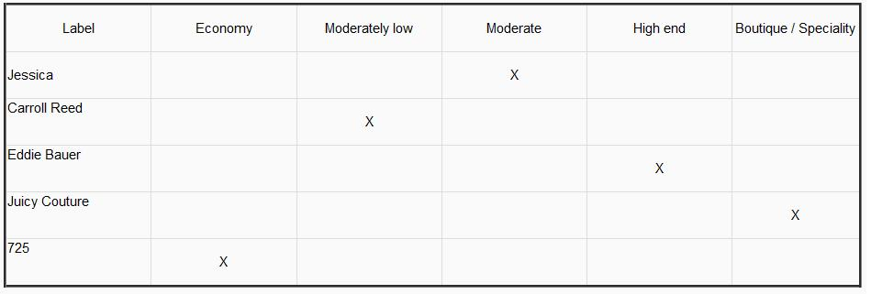
Understanding Quality Goods
Workplace resources

Slide 16
Respectful Workplaces
Designed to introduce employees to Bill 168 and workplace harassment
Teaches:
How to deal with a difficult customer or co-worker
Recognizing the signs of bullying in the workplace
What to do if workplace harassment is present or suspected

Slide 17
Internal Policy Refresher
Designed to give employees a brush-up on Goodwill policies and procedures
Reviews:
Goodwill mission and values
Approved and unapproved absences
Vacation time and vacation pay
Staff complaints and concerns

Slide 18
Health and Safety
Designed to encourage safety in the workplace
Teaches:
Goodwill health and safety policy and procedures
Correct use of equipment and materials
Emergency evacuation plan
Health and safety forms

Slide 19
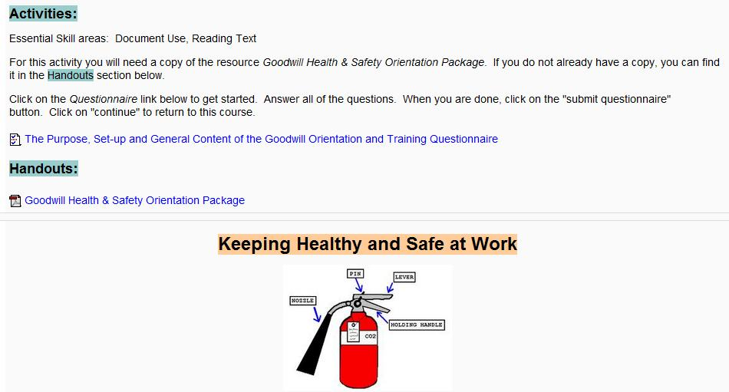
Health and Safety
Job-related documents

Slide 20
WHMIS
Designed as a supplement to annual WHMIS training for all employees
Teaches:
Understanding WHMIS labels
Recognizing WHMIS hazard symbols
Handling materials safely
Reading a Material Safety Data Sheet (MSDS)

Slide 21
WHMIS
Authentic workplace documents

Slide 22
Business Metrics
Designed to demonstrate the measures that determine success at Goodwill
Teaches:
Budgets
Web enabled sales analysis (WESA)
Targets
Key Performance Indicators and benchmarks

Slide 23
Business Metrics
Writing activities

Slide 24
How to Read Your Pay Stub
Designed to help employees understand the line items on Goodwill pay stubs
Teaches:
Gross pay vs. net pay
How pay amount is calculated
Pay stub short forms

Slide 25
Loss Prevention
Designed to demonstrate the signs of internal and external theft
Teaches:
Recognizing shoplifters
Recognizing internal theft
Steps to take if theft is suspected at Goodwill

Slide 26
Loss Prevention
Goodwill policies

Slide 27
Family Literacy
Designed for employees with children, grandchildren or young dependents
Includes interactive activities to promote literacy
Teaches:
Recognizing the importance of good literacy skills
Encouraging a positive learning environment
Ways to help the child increase their literacy skills while the employees’ skills are also improving

Slide 28
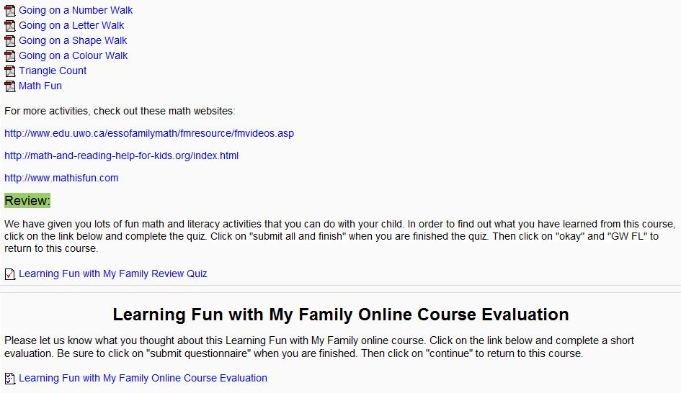
Family Literacy
Printable interactive activities
Module evaluations

Slide 29
Post-Assessments
PDQ and CAMERA assessments in progress now
Post-assessments being performed on all staff who had pre-assessments in 2010
So far, there have been slight improvements in scores, but we won’t have all the data until March 31, 2011

Slide 30
Questions?

